Slide 1
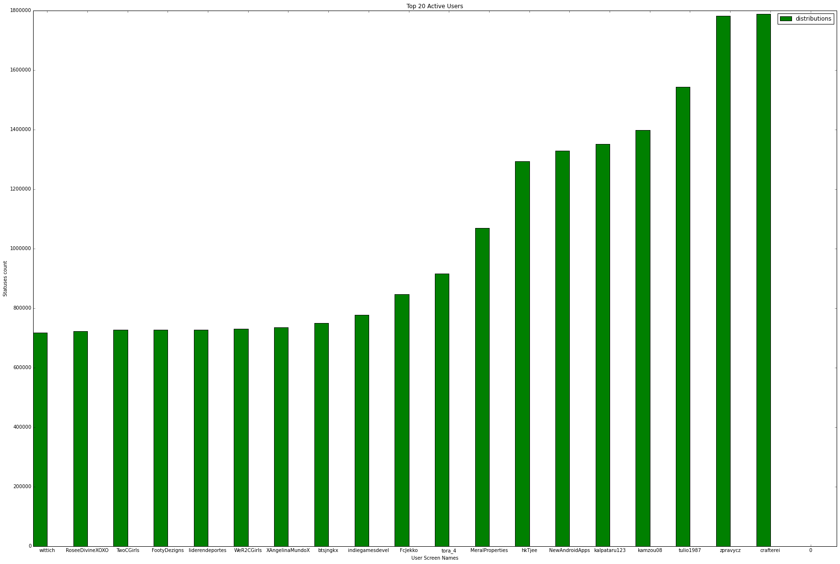
Query 1:
Description: To find top active users in dataset
SELECT TWEET_USER_SCREEN_NAME, MAX(TWEET_USER_STATUSES_COUNT) AS TWEET_USER_STATUSES_COUNT FROM tweetdata group by TWEET_USER_SCREEN_NAME order by TWEET_USER_STATUSES_COUNT DESC LIMIT 20
Visualization:

Slide 2
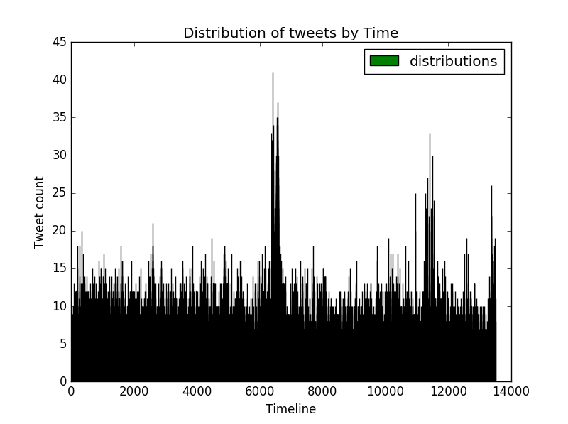
Query 2:
Description: To find users per year
val tweetCreatedDt = tweets.filter(_.nonEmpty).map(x => (extractTweetDate(x), 1)) val tweetCreatedDtCnt = tweetCreatedDt.reduceByKey((a, b) => a + b) tweetCreatedDtCnt.repartition(1).saveAsTextFile("D:/UMKC/Docs/Subjects/PBDM/PB_Project/TweetsPerTime")
Visualization:

Slide 3
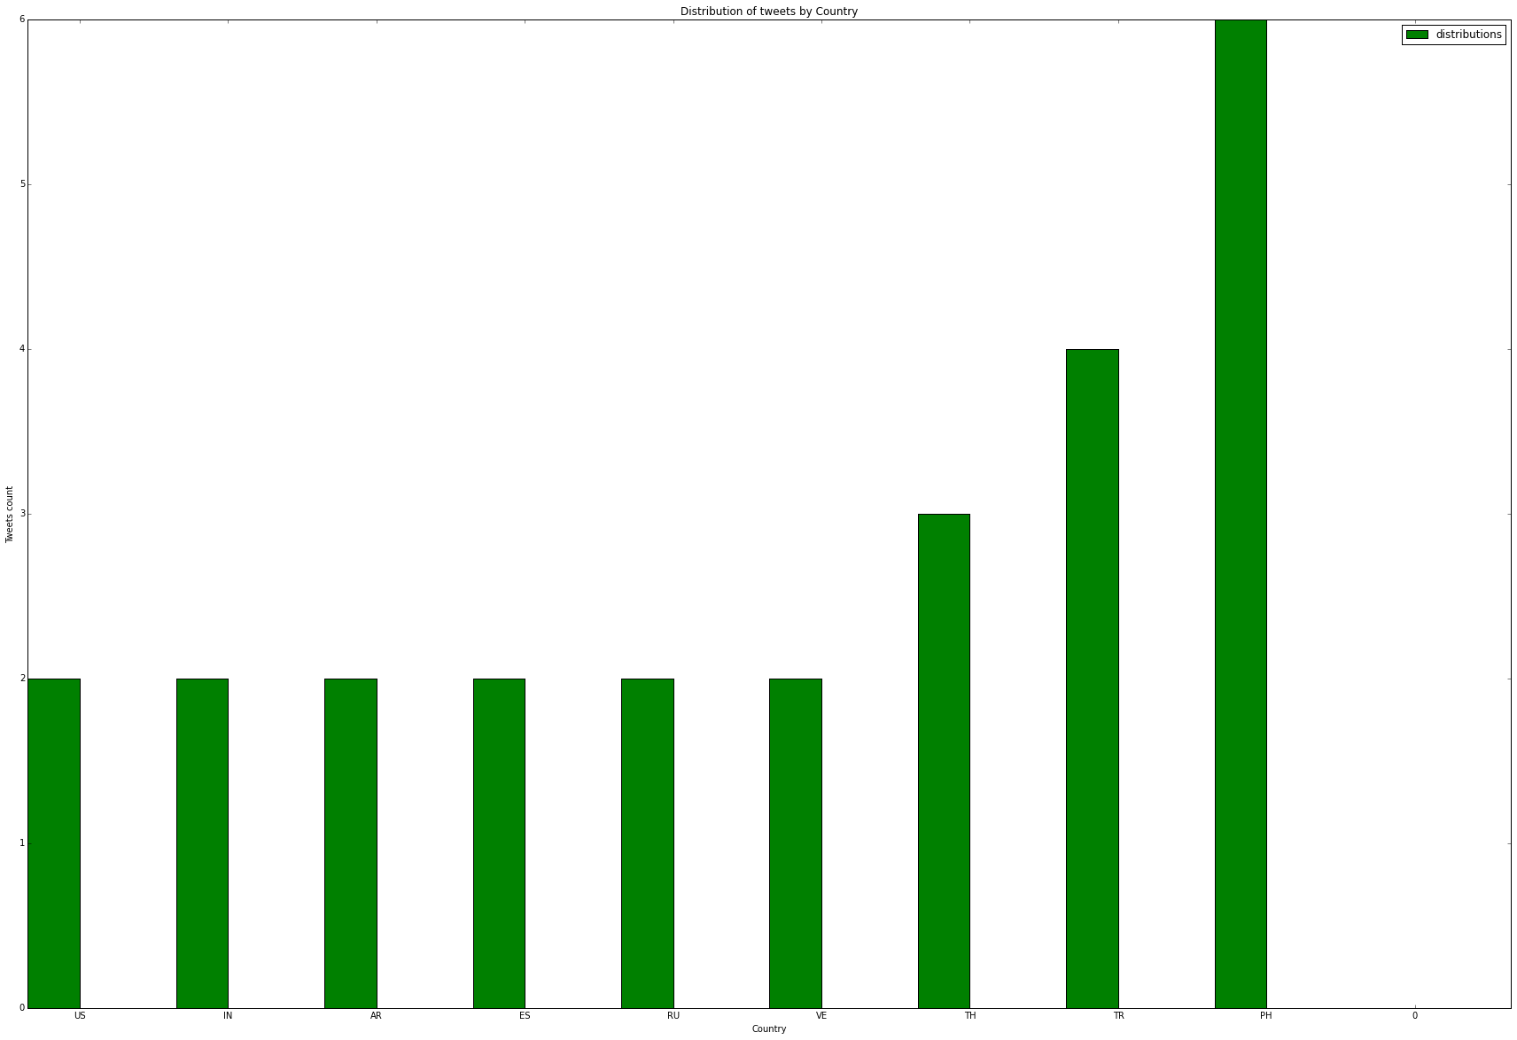
Query 3:
Description: To find tweets per country
SELECT TWEET_PLACE_COUNTRY_CODE, COUNT(1) AS TWEETS_PER_COUNTRY FROM tweetdata group by TWEET_PLACE_COUNTRY_CODE order by TWEETS_PER_COUNTRY DESC LIMIT 10
Visualization:

Slide 4
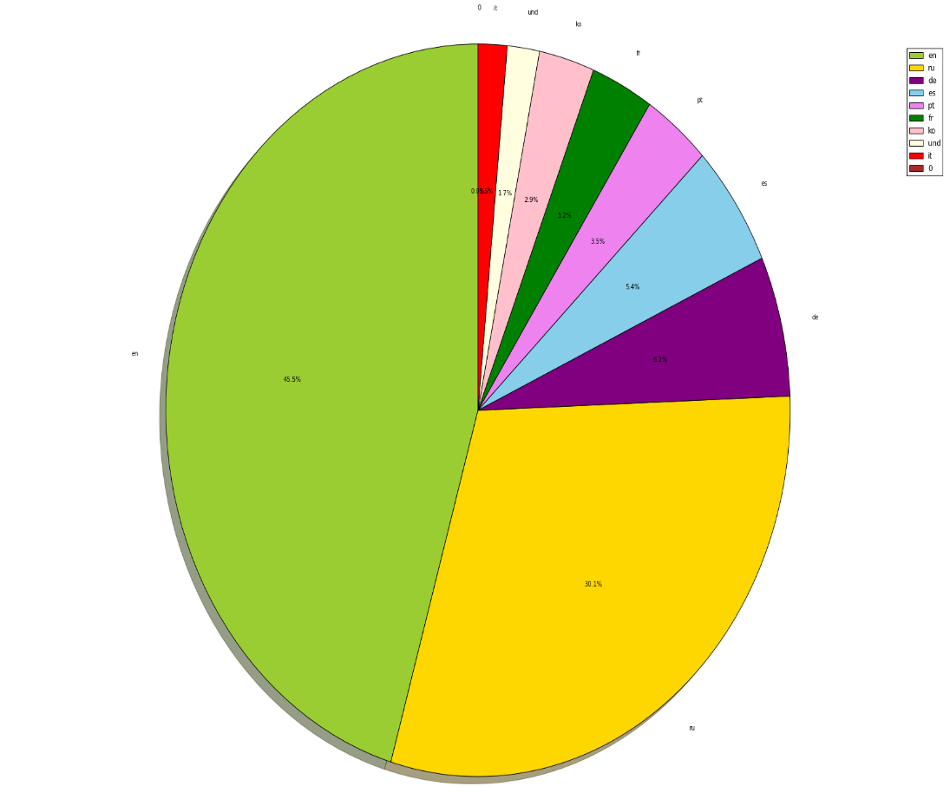
Query 4:
Description: To find number of tweets per language
SELECT TWEET_LANG, count(1) as totTweets from tweetdata group by TWEET_LANG order by totTweets
Visualization:

Slide 5
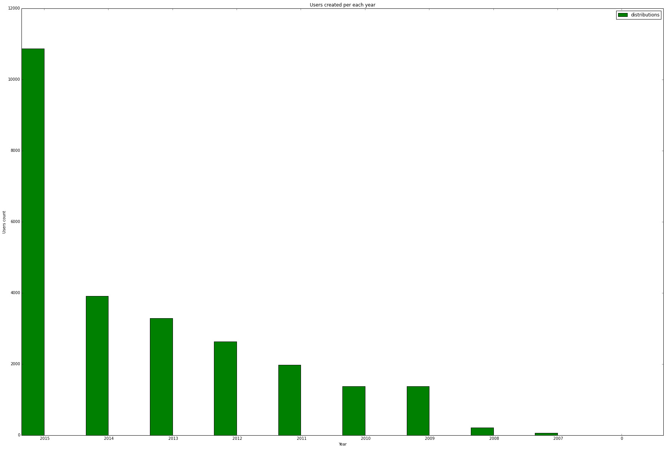
Query 5:
Description: To find user accounts created per year
SELECT t1.YR as YR, count(1) as CNT FROM (select DISTINCT TWEET_USER_ID, substring(TWEET_USER_CREATED_AT,26) AS YR FROM tweetdata where TWEET_USER_CREATED_AT IS NOT NULL) t1 group by YR order by YR
Visualization:

Slide 6
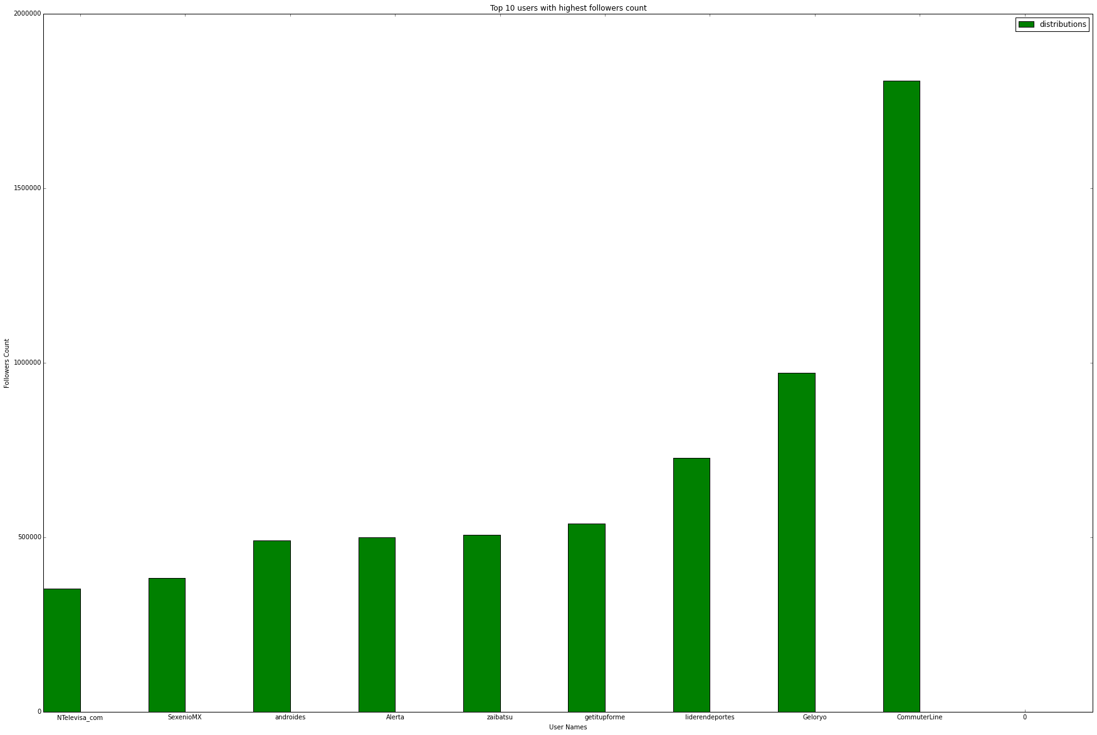
Query 6:
Description: To find Top Users with highest Followers Count
SELECT TWEET_USER_SCREEN_NAME, MAX(TWEET_USER_FOLLOWERS_COUNT) AS TWEET_USER_FOLLOWERS_COUNT FROM tweetdata group by TWEET_USER_SCREEN_NAME order by TWEET_USER_FOLLOWERS_COUNT DESC LIMIT 10
Visualization:

Slide 7
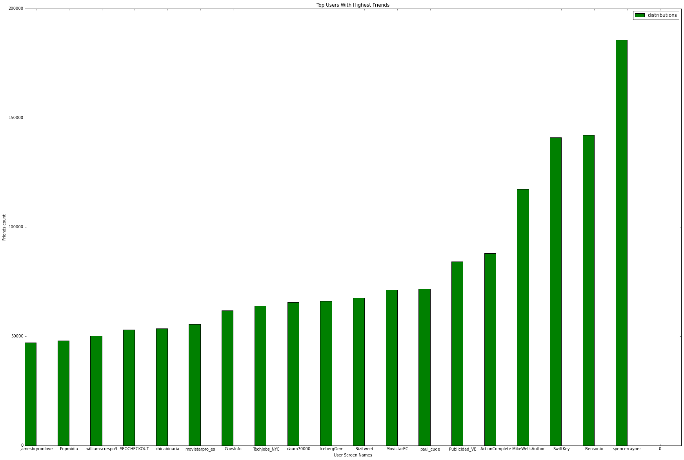
Query 7:
Description: To find Top Users with highest Friends Count
SELECT MAX(TWEET_USER_FRIENDS_COUNT) AS FRIENDS_COUNT, TWEET_USER_SCREEN_NAME FROM tweetdata GROUP BY TWEET_USER_SCREEN_NAME ORDER BY FRIENDS_COUNT DESC LIMIT 20
Visualization:

Slide 8
Conclusion:
Social media provides valuable datasets, but the real challenge is in collecting and analyzing the live streaming data. In this project we’ve analyzed and visualized twitter data on a #android keyword.
In future work, we would like to perform domain specific live streaming analysis and try to capture valuable insights from data.
Acknowledgements:
We would like to thank Dr.Rao , Anas Katib and Venu Kolla for their extended support in successful execution of this project.

